Slide 1
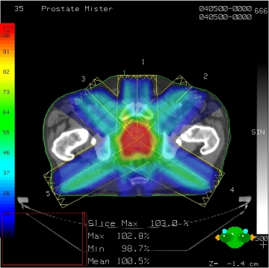
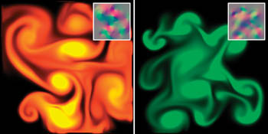
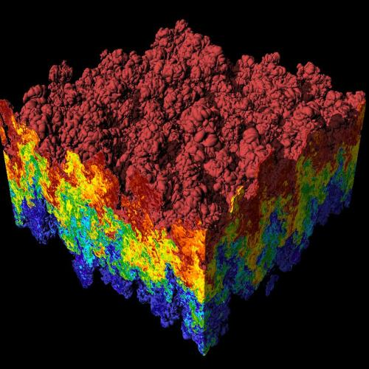
CS 179: GPU Programming
Lecture 1: Introduction
Images: http://en.wikipedia.org
http://www.pcper.com
http://northdallasradiationoncology.com/
GPU Gems (Nvidia)
Notes:
1

Slide 2
Administration
Covered topics:
(GP)GPU computing/parallelization
C++ CUDA (parallel computing platform)
TAs:
cs179tas@googlegroups.com for set submission and extension requests
George Stathopoulos (gstathop@caltech.edu)
Mary Giambrone (mgiambro@caltech.edu)
Jenny Lee (clee7@caltech.edu)
Website (course website is being updated):
http://courses.cms.caltech.edu/cs179/
http://www.piazza.com/caltech/spring2019/cs179
Overseeing Instructor:
Al Barr (barr@cs.caltech.edu)
Class time:
ANB 107, MWF 3:00 PM, attendance recommended but not required
Recitations on Fridays

Slide 3
Course Requirements
Fill out survey for class times and set submission:
https://forms.gle/brBfBgvDv4voeERF9
Fill out this when2meet for office hours: https://www.when2meet.com/?7707636-okI5Y
Homework:
6 weekly assignments
Each worth 10% of grade
Final project:
4-week project
40% of grade total
P/F Students must receive at least 60% on every assignment AND the final project

Slide 4
Homework
Due on Wednesdays before class (3PM)
First set out April 3th, due April 10th
Upcoming sets will use survey’s due date
Collaboration policy:
Discuss ideas and strategies freely, but all code must be your own
Do not look up prior years solutions or reference solution code from github without prior TA approval
Office Hours: Located in ANB 104
Times: TBA (will be announced before first set is out)
Extensions
Ask a TA for one if you have a valid reason

Slide 5
Projects
Topic of your choice
We will also provide many options
Teams of up to 2 people
2-person teams will be held to higher expectations
Requirements
Project Proposal
Progress report(s) and Final Presentation
More info later…

Slide 6
Machines
Primary GPU machine available
Currently being setup. You will receive a user account after emailing cs179tas@googlegroups.com
Titan: titan.cms.caltech.edu (SSH, maybe Mosh)
Secondary machines
mx.cms.caltech.edu
minuteman.cms.caltech.edu
These use your CMS login
NOTE: Not all assignments work on these machines
Change your password from the temp one we send you
Use passwd command

Slide 7
Machines
Alternative: Use your own machine:
Must have an NVIDIA CUDA-capable GPU
At least Compute 3.0
Virtual machines won’t work
Exception: Machines with I/O MMU virtualization and certain GPUs
Special requirements for:
Hybrid/optimus systems
Mac/OS X
Setup guide on the website is outdated. Follow NVIDIA’s posted 2019 installation instructions (linked on page)

Slide 8
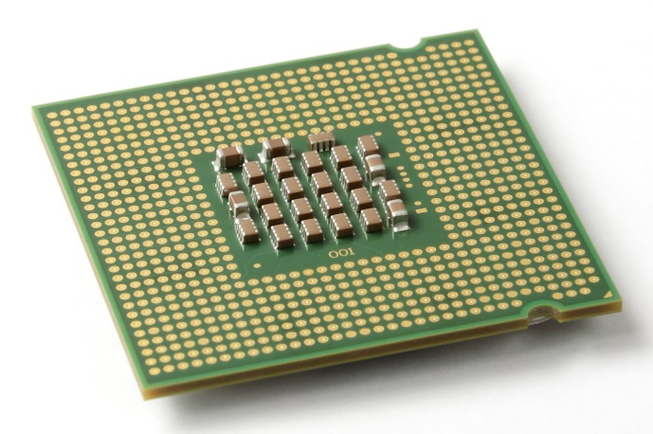
The CPU
The “Central Processing Unit”
Traditionally, applications use CPU for primary calculations
General-purpose capabilities
Established technology
Usually equipped with 8 or less powerful cores
Optimal for concurrent processes but not large scale parallel computations
Wikimedia commons: Intel_CPU_Pentium_4_640_Prescott_bottom.jpg

Slide 9
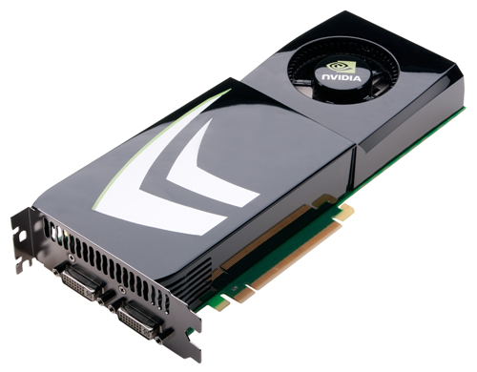
The GPU
The "Graphics Processing Unit"
Relatively new technology designed for parallelizable problems
Initially created specifically for graphics
Became more capable of general computations

Slide 10
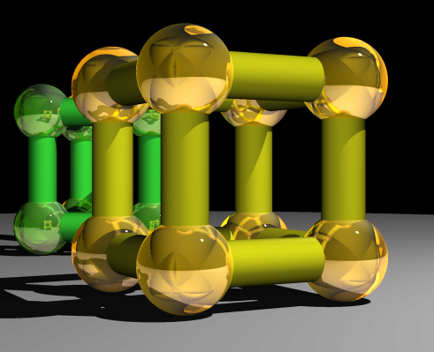
GPUs – The Motivation
Raytracing:
for all pixels (i,j):
Calculate ray point and direction in 3d space
if ray intersects object:
calculate lighting at closest object
store color of (i,j)
Superquadric Cylinders, exponent 0.1, yellow glass balls, Barr, 1981

Slide 11
EXAMPLE
Add two arrays
A[ ] + B[ ] -> C[ ]
On the CPU:
float *C = malloc(N * sizeof(float));
for (int i = 0; i < N; i++)
C[i] = A[i] + B[i];
return C;
This operates sequentially… can we do better?

Slide 12
A simple problem…
On the CPU (multi-threaded, pseudocode):
(allocate memory for C)
Create # of threads equal to number of cores on processor (around 2, 4, perhaps 8)
(Indicate portions of A, B, C to each thread...)
...
In each thread,
For (i from beginning region of thread)
C[i] <- A[i] + B[i]
//lots of waiting involved for memory reads, writes, ...
Wait for threads to synchronize...
This is slightly faster – 2-8x (slightly more with other tricks)

Slide 13
A simple problem…
How many threads? How does performance scale?
Context switching:
The action of switching which thread is being processed
High penalty on the CPU
Not an issue on the GPU

Slide 14
A simple problem…
On the GPU:
(allocate memory for A, B, C on GPU)
Create the “kernel” – each thread will perform one (or a few) additions
Specify the following kernel operation:
For all i‘s (indices) assigned to this thread:
C[i] <- A[i] + B[i]
Start ~20000 (!) threads
Wait for threads to synchronize...

Slide 15
GPU: Strengths Revealed
Emphasis on parallelism means we have lots of cores
This allows us to run many threads simultaneously with no context switches

Slide 16
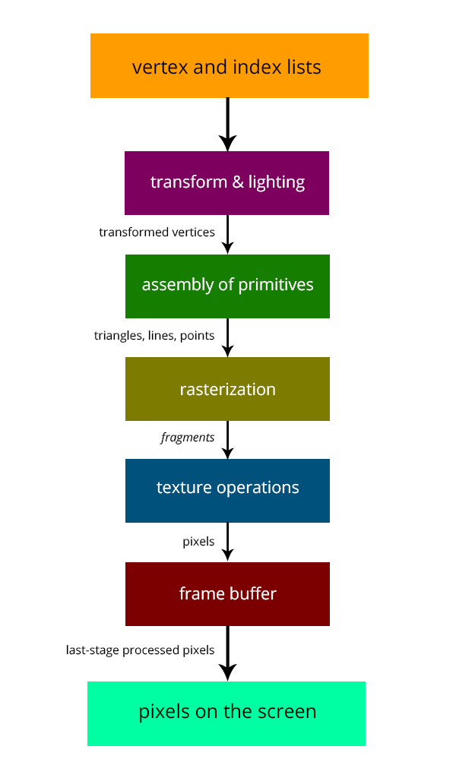

GPUs – Brief History
Initially based on graphics focused fixed-function pipelines
Pre-set functions, limited options
http://gamedevelopment.tutsplus.com/articles/the-end-of-fixed-function-rendering-pipelines-and-how-to-move-on--cms-21469
Source: Super Mario 64, by Nintendo

Slide 17

GPUs – Brief History
Shaders
Could implement one’s own functions!
GLSL (C-like language), discussed in CS 171
Could “sneak in” general-purpose programming!
Vulkan/OpenCL is the modern multiplatform general purpose GPU compute system, but we won’t be covering it in this course
http://minecraftsix.com/glsl-shaders-mod/

Slide 18
Using GPUs
“General-purpose computing on GPUs” (GPGPU)
Hardware has gotten good enough to a point where it’s basically having a mini-supercomputer
CUDA (Compute Unified Device Architecture)
General-purpose parallel computing platform for NVIDIA GPUs
Vulkan/OpenCL (Open Computing Language)
General heterogenous computing framework
Both are accessible as extensions to various languages
If you’re into python, checkout Theano, pyCUDA.
Notes:
Supercomputers are tons of processing cores sharing the workload of a parallelized task. GPUs are in fact often at the core of most modern supercomputers

Slide 19
GPU Computing: Step by Step
Setup inputs on the host (CPU-accessible memory)
Allocate memory for outputs on the host
Allocate memory for inputs on the GPU
Allocate memory for outputs on the GPU
Copy inputs from host to GPU
Start GPU kernel (function that executed on gpu)
Copy output from GPU to host
NOTE: Copying can be asynchronous, and unified memory management is available

Slide 20
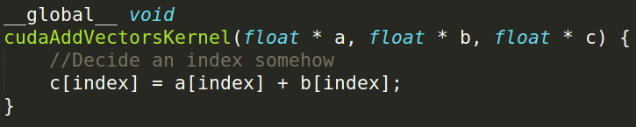
The Kernel
Our “parallel” function
Given to each thread
Simple implementation:

Slide 21
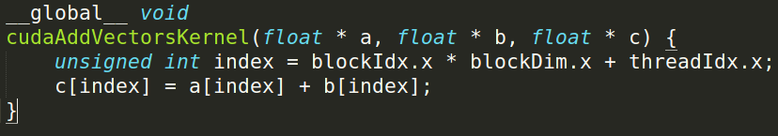
Indexing
Can get a block ID and thread ID within the block:
Unique thread ID!
https://cs.calvin.edu/courses/cs/374/CUDA/CUDA-Thread-Indexing-Cheatsheet.pdf
https://en.wikipedia.org/wiki/Thread_block

Slide 22
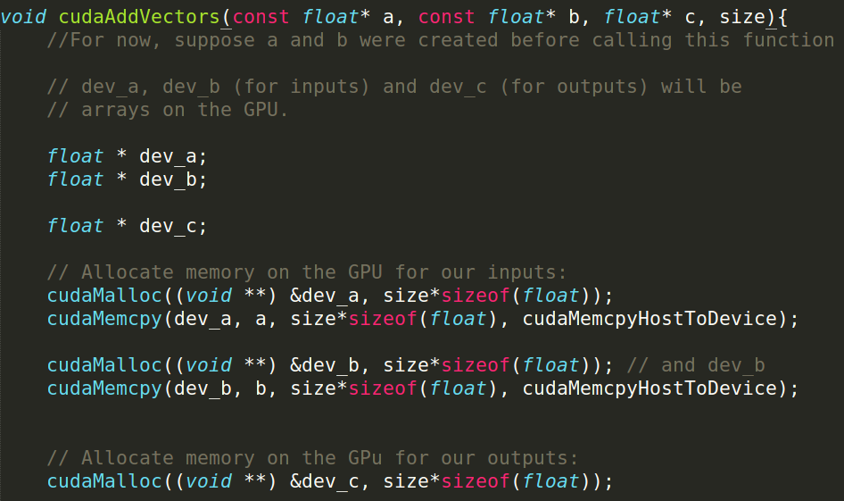
Calling the Kernel

Slide 23
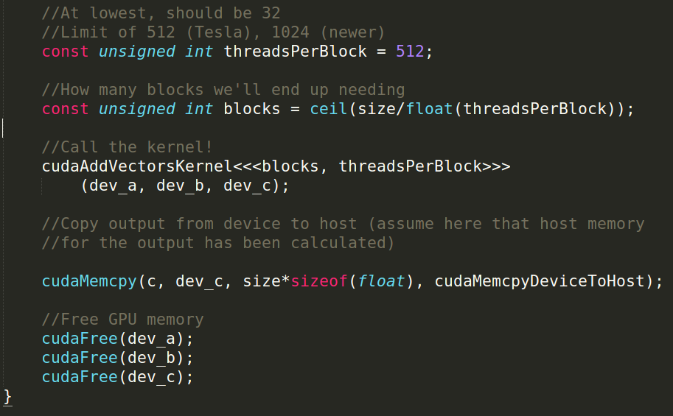
Calling the Kernel (2)

Slide 24

Questions?

